Slide 1
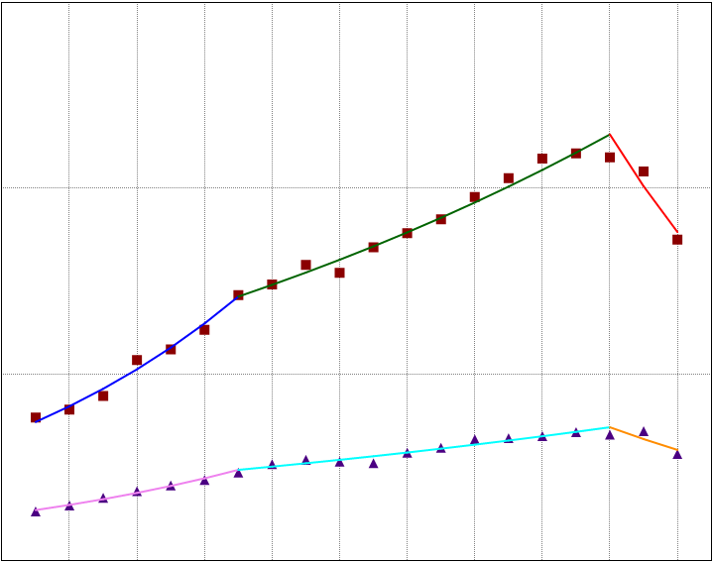
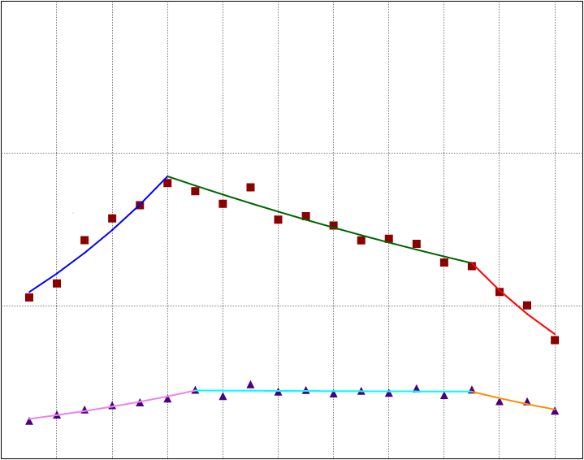
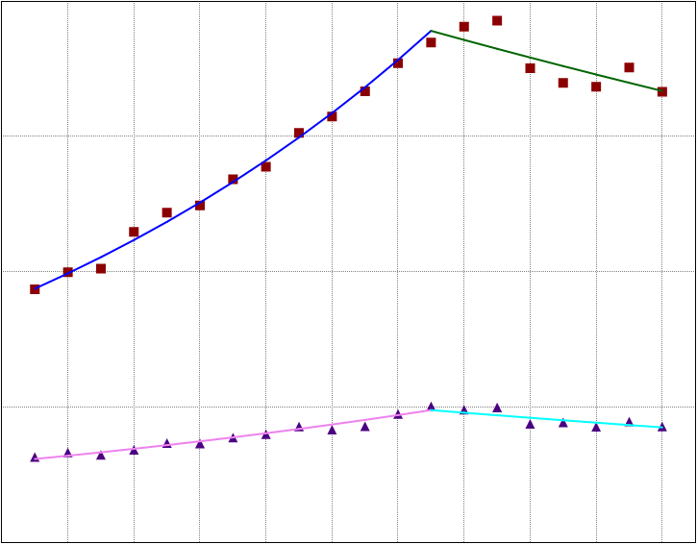
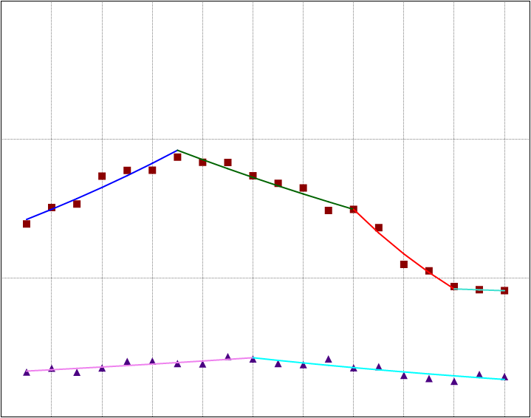
A
B
A
Early Stage Aged ≥55 years
B
Early Stage Aged <55 years
30
3
Men
20
2
Age-Adjusted Incidence Rate (per 100,000 population)
Age-Adjusted Incidence Rate (per 100,000 population)
Men
10
Women
1
Women
0
0
2000 2002 2004 2006 2008 2010 2012 2014 2016 2018 2020
2000 2002 2004 2006 2008 2010 2012 2014 2016 2018 2020
Year
Year
C
D
Late Stage Aged <55 years
C
Late Stage Aged ≥55 years
D
20
3
15
Men
2
10
Age-Adjusted Incidence Rate (per 100,000 population)
Men
Age-Adjusted Incidence Rate (per 100,000 population)
Women
1
5
Women
0
0
2000 2002 2004 2006 2008 2010 2012 2014 2016 2018 2020
2000 2002 2004 2006 2008 2010 2012 2014 2016 2018 2020
Year
Year

